Slide 1

Digital Portfolio
STUDENT NAME :M.DEVADHARSHINI
NM ID:4E30C3C13169545A2554C51338D9F87E
DEPARTMENT : B.SC Information Technology
COLLEGE : KAAMADHENU ARTS AND SCIENCE COLLEGE/BHARATHIYAR UNIVERSITY
Nandha Kumar.M
‹#›
Notes:
‹#›

Slide 2

PROJECT TITLE
Personal Portfolio Website – Showcasing Skills and Achievements
‹#›

Slide 3




AGENDA
Problem Statement
Project Overview
End Users
Tools and Technologies
Portfolio design and Layout
Features and Functionality
Results and Screenshots
Conclusion
Github Link
3/21/2024 Annual Review
‹#›

Slide 4

PROBLEM STATEMENT
In today’s digital era, having an online presence is essential for students and professionals. A well-structured portfolio helps to showcase skills, education, and achievements to potential employers and collaborators. Without a portfolio, opportunities may be missed as there is no centralized platform to demonstrate one’s expertise and projects.
‹#›

Slide 5

PROJECT OVERVIEW
This project is a personal Portfolio Website designed and developed by devadharshini.
It highlights my skills, education, projects, and achievements in a visually appealing and interactive format.
The goal is to provide recruiters, peers, and professionals with an overview of my abilities and accomplishments in the field of software development and web technologies.
‹#›

Slide 6

WHO ARE THE END USERS?
Recruiters & Hiring Managers – to evaluate my skills and experience.
Peers & Collaborators – to connect for projects, hackathons, or open-source contributions.
Faculty & Mentors – to assess my learning journey and growth.
General Audience – anyone interested in exploring my work and achievements.
‹#›

Slide 7
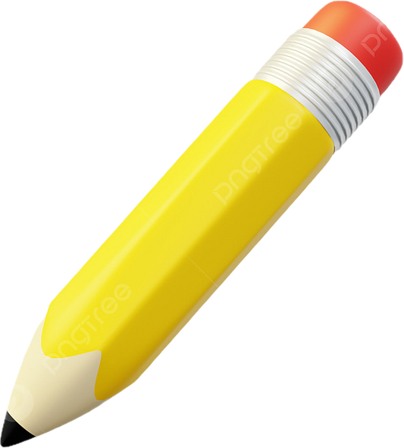
TOOLS AND TECHNIQUES
Frontend: HTML, CSS, JavaScript
Programming Languages: C, C++
Design: Responsive Web Design principles, modern UI layouts
Database Knowledge: Basic MySQL (future expansion for dynamic portfolio)
Other Tools: VS Code, GitHub for version control
‹#›

Slide 8
POTFOLIO DESIGN AND LAYOUT
The portfolio follows a clean, modern, and responsive layout with the following sections:
1. Home/About Me – Introduction and personal summary
2. Skills – Technical expertise with icons and highlights
3. Education – Academic background and learning highlights
4. Projects – Showcasing completed projects with descriptions
5. Achievements – Certifications, competitions, and milestones
6. Contact – Links to email and social profiles
‹#›

Slide 9
FEATURES AND FUNCTIONALITY
🎨 Responsive Design – Optimized for mobile, tablet, and desktop
🖼️ Project Showcase – Highlights mini-projects with details
🔗 Navigation Bar – Smooth scrolling to sections
🌐 Social Links – Easy connection via email or GitHub/LinkedIn
⚡ Interactive Elements – Hover effects, animations, and engaging UI

Slide 10

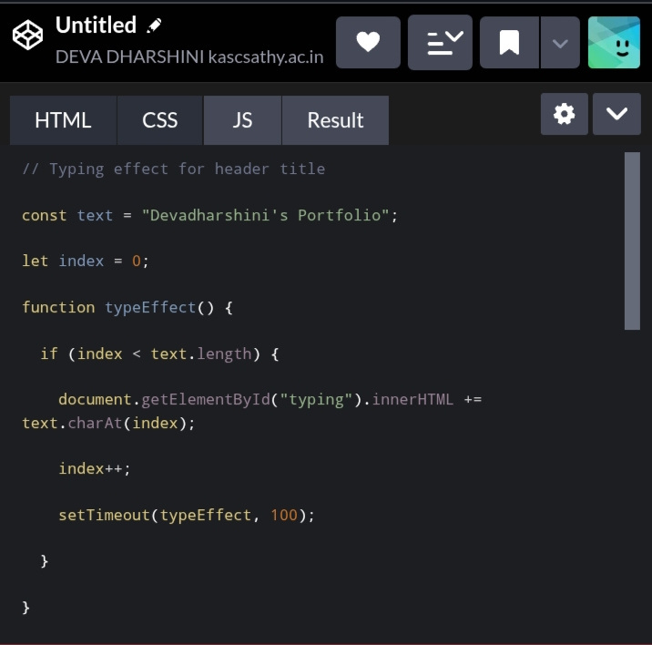
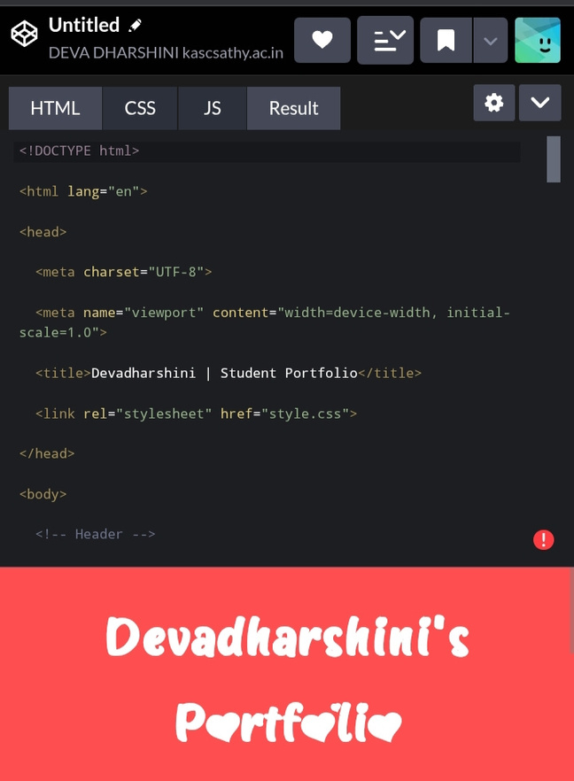
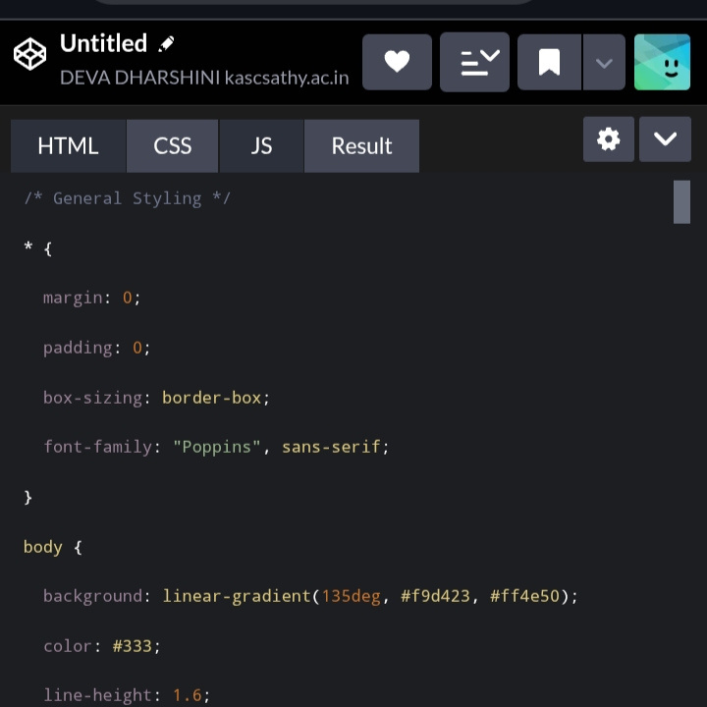
RESULTS AND SCREENSHOTS
‹#›

Slide 11
CONCLUSION
This portfolio project helped me apply my knowledge of HTML, CSS, and JavaScript while improving my design and problem-solving skills.
It serves as a foundation for my professional career and will be continuously updated with new projects, skills, and achievements.
The project not only strengthens my web development expertise but also acts as a gateway for opportunities in internships and future employment.
‹#›

